Slide 1

Neo4j
Aaradhy Sharma
Ankita Dharurkar
Dhaval Patel

Slide 2

Definition
Neo4j is a highly scalable, native graph database purpose-built to leverage not only data but also its relationships.
Neo4j’s native graph storage and processing engine deliver constant, real-time performance, helping enterprises build intelligent applications to meet today’s evolving data challenges.

Slide 3
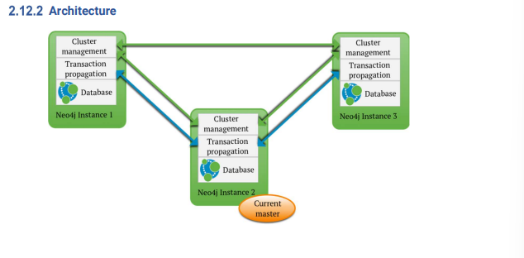
Architecture
Write transactions can be performed on any database instance in a cluster.
Neo4j cluster is fault-tolerant and can continue to operate from any number of machines down to a single machine.
Slaves will be automatically synchronized with the master on write operations.
If the master fails, a new master will be elected automatically.

Slide 4
Architecture
The cluster automatically handles instances becoming unavailable and makes sure to accept them as members in the cluster when they are available again.
Transactions are atomic, consistent, and durable but eventually propagated out to other slaves.
Updates to slaves are eventually consistent by nature but can be configured to be pushed optimistically from master during commit.

Slide 5
Scalability
The Neo4j scalability package is known as high availability or HA.
Full data redundancy
Service fault tolerance
Linear read scalability
Redundancy: In a Neo4j HA cluster, the full graph is replicated to each instance in the cluster. This means that the full dataset is replicated across the entire cluster, to each server
Scaling Read Throughput: Although write operations are performed in unison with the elected master, read operations can be done locally on each slave

Slide 6
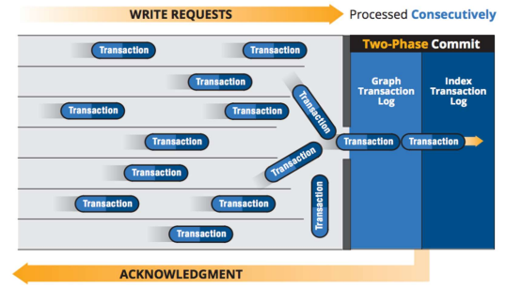
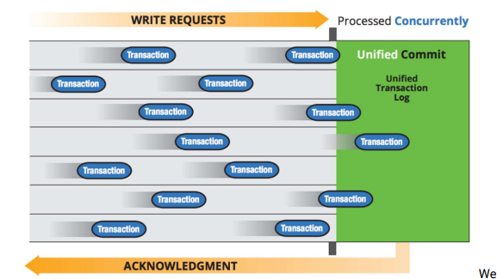
Neo4j 2.2 update (2015)
MASSIVE WRITES:- Up to 100 times higher write throughput
Vastly improved core scale-up, to utilize modern hardware more fully.
Faster Cypher Query Performance:-Up to 100 times faster query performance
Cost-Based Optimizer The new cost-based optimizer is much smarter at planning queries and more transparent about what it’s doing. The new statistics-gathering capability tracks the scale and the shape of the graph.

Slide 7
Security
By default, the Neo4j Server is bundled with a Web server that binds to host localhost on port 7474, answering only requests from the local machine.
Default - dbms.connector.http.type=HTTP
dbms.connector.http.enabled=true
If you want the server to listen to external hosts, configure the Web server in neo4j.conf by setting the property dbms.connector.http.address=0.0.0.0:7474 which will cause the server to bind to all available network interfaces.

Slide 8
Server authentication and authorization
Server authentication and authorization Neo4j requires clients to supply authentication credentials when accessing the REST API. Without valid credentials, access to the database will be forbidden.
The authentication and authorization data are stored under data/dbms/auth. If necessary, this file can be copied over to other neo4j instances to ensure they share the same username/password.
When accessing Neo4j over unsecured networks, make sure HTTPS is configured and used for access.
If necessary, authentication may be disabled. This will allow any client to access the database without supplying authentication credentials.
Disable Authorization - dbms.security.auth_enabled=false

Slide 9
Manageability
Two parts
1. Cluster Management
The cluster management component continuously stays in sync with all instances in the cluster, keeping track of any instances joining or leaving.
When a master election becomes necessary, the cluster management component ensures that a new master is consistently elected.
2. Database management

Slide 10
a. Managing Large Datasets
Index free adjacency - graph database can find the neighbors of any given node without having to consider the full set of relationships in the graph.
Neo4j makes use of a concept known as cache-based sharding. It mandates consistent request routing. For instance, requests for user A are always sent to server 1, while requests for user B are always sent to server 2,
b. Managing High Write Load
Neo4j HA makes use of a single master to coordinate all write operations
Neo Technology actively supports customers operating on SSD drives such as Fusion-io, achieving exceptional write load and easily sustaining a rapidly growing business with plenty of capacity to spare.

Slide 11
Prerequisites
Neo4j (Network Exploration and Optimization 4 Java) is a graph database written in Java with native graph storage and processing. The main features of Neo4j are:
It is required to have a pre-installed, compatible Java Virtual Machine (JVM), to run a Neo4j instance.
For proper ACID behavior, the filesystem must support flush (fsync, fdatasync).
Neo4j version and JVM requirements.
Neo4j Version | JVM compliancy
3.x | Java SE 8 Platform Specification
4.x | Java SE 11 Platform Specification

Slide 12
Benefits
Process big data
Neo4j can handle large scale of datasets without sacrificing the application performance. Neo4j team has also recently released a library that allows running graph algorithms in parallel on several billion nodes and tens of billions of relationships in 1-2 hours.
Manage relationships between data
With Neo4j you can explore different paths and connections between your data and query them more efficiently. You can also easily fetch complex data from the database even if they're highly connected.
Answer complex queries with high performance
Neo4j scales horizontally, so its performance doesn’t depend on the database size. It traverses large sets of connected data and has such enterprise-grade database features as ACID transactions and automated backup/recovery.

Slide 13
Pitfalls
Language based library
Support for language based libraries. Currently, Neo4J only supports Java-based libraries. It helps if Neo4J supports libraries in popular languages like Python.
All data resides on each machine
You need that data in-memory if you want to avoid expensive disk seeks. So once your data-sets become larger than the available RAM the system will dramatically slow down
Scalability
Writes are always done on the master because Neo4J works on Master-Slave architecture. Even if you try to write on a slave, the write will be forwarded to the master internally. Good thing is that once a master goes down, it doesn't take long until a new master is elected.

Slide 14
Companies using Neo4j
Ebay
Ebay uses Neo4j to enhance the same day delivery service. Its main goal was to decrease the wait - the main hurdle between retailers and online shoppers.
They've used MySQL before, but it wasn’t up to this task. The queries used for calculating the best route took too long time and were difficult to maintain.
Airbnb
With the growth of Airbnb, the number of its internal data resources went up. It turned out in the necessity to search, navigate and manage these data effectively, see how data are related and empower all employees to be data-informed.
They decided to create a dataportal and Neo4j together with Elastic search were the best for this purpose.
Cisco
Cisco uses graph database Neo4j for data mining customer support case notes. Any time the issue appears in the system, engineers log case notes about it. Then, Cisco team loads these issues into Neo4j together with rich meta data about the team member, group he/she belongs to and the case itself.

Slide 15
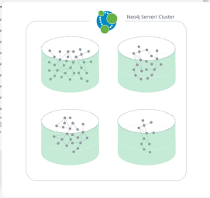
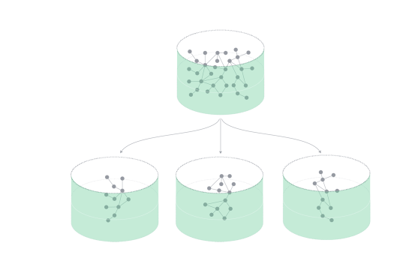
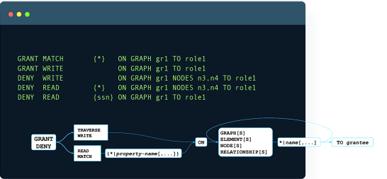
Neo 4j 4.0 Update
Unlimited Scalability:-no data volume restriction
Granular Security:- with Neo4j 4.0, developers and administrators now have more control over access to data for security and privacy purposes.
Operational Flexibility Neo4j 4.0 adds multi-database capabilities with separation of data, allowing multiple databases to be run inside a single Neo4j cluster.
Reactive Architecture: being responsive, resilient, elastic, and message-driven to deliver maximum scalability and performance.

Slide 16
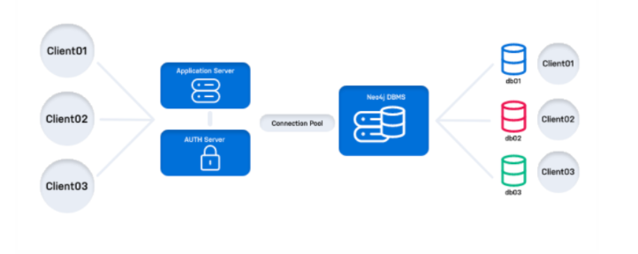
Neo 4j :- 4.4.4 Latest update:- 2022-02-09
Cypher CALL {…} IN TRANSACTIONS - You can now start one or more transactions from within a transaction. this new Cypher clause provides a massive gain in data processing and reduces memory requirements when importing very large datasets.
Cloud-Native API (HTTP) -> Accelerate application development Connect to Neo4j using a cloud-native API and simplified routing without middleware or the use of language drivers.
Single Sign-On (SSO) for Browser, Bloom, and the Neo4j Graph Database -> Logging in made easy
Zero Downtime for Remote Database Administration (coming soon)
User Impersonation -> Build secure multi-tier applications queries can now inherit permissions from an arbitrary user by passing a user id into the connection pool.

